Slide 1


Financial
Management
Assistant
By Steven de Jesus
and Davor Vukoja

Slide 2


User Need Statement:
Blue collar trades workers need a simple financial management tool, that will cater to their financial needs. This will allow them to accurately keep track of their company’s finances and most importantly save them time.
z

Slide 3
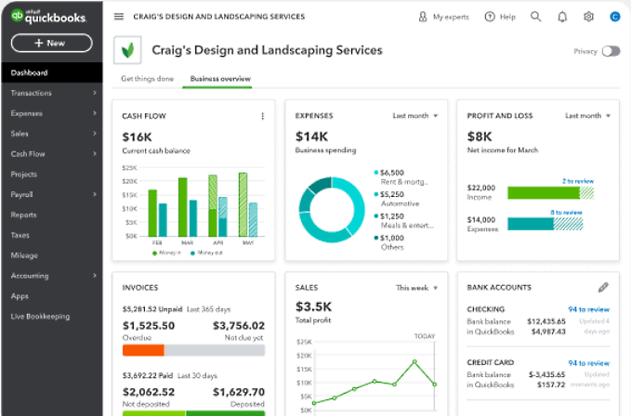
Our Basis
We’re basing our functionality and UI on an existing software named QuickBooks, which Davor and an interviewee has had first-hand experience with.
Although this financial management tool could get the job done, it requires tutorials to navigate through the UI and all the information and displays it throws at you, to get to what you need. It may be intuitive to somebody with professional finance experience or education, but not to an older blue-collar tradesman without sophisticated education on finance.
This can lead to confusion and wasting time, as it takes extra time for the user to find what they seek because it could be hidden in a section that they wouldn’t expect, like if employee healthcare information was under “payroll” instead of “expenses”.

Slide 4

Setting
Goals:
Our goal is to streamline the experience by simplifying the User Interface to provide only the necessary information to the user. When we avoid the complexities, we will reduce the confusion and get the user closer to their goal much faster

Slide 5

Functional Requirement:
The functional requirements applicable for the improved UI is simplicity, meaning less distractions. Less distractions would mean less buttons, less out of context graphs, and perhaps just one simple income/revenue graph on the home page instead of many different graphs and images that can distract from the user’s goal.

Slide 6

Environmental Requirement:
By nature, the project will be an organizational tool to organize finances. For people who are working manual labor for hours at a time, this UI needs to be as streamlined as possible to waste as little time as possible, since they’re doing all the business themselves. Labor, bookkeeping, etc.

Slide 7
The people we plan to gather requirements from are characterized by someone older, not experts in financial tools and terms, with stubborn attitudes.
A fatigued person who doesn’t focus on the intricacies of finance due to the many other responsibilities they have for their business.
They can’t spend extra time and effort on learning and searching a clunky financial management tool after a long day of work.
Who is our target user?

Slide 8

The People We Talked to:
Ramiz Bikic: A 55-year-old Bosnian Master Carpenter with more than 35 years of construction experience.
Jacob Hess: A 48-year-old mechanic with more than 15 years of shop experience
Zdravko Vukoja: A 50-year-old Croatian Master Carpenter, with 25 years of construction experience

Slide 9

The interviews took place the week of Sept. 11 since Davor had been planning something like this for some time, and he interviewed them in the style of a natural conversation, where he asked them planned questions and recorded notes, but in their living rooms, sharing coffee with them.
From these 9 questions, we gathered enough information to understand their needs and requirements.

Slide 10

Questions:
What is your primary method of keeping track of your finances for your business and why do you use it? ​
Why do you think it is important for you to keep track of your finances? ​
How much time do you want to spend taking care of your finances and compared to that how much time do you dedicate to it? ​
What do you think are the best upsides about how you manage your finances? ​
What do you think are the worst downsides about how you manage your finances? ​
Do you feel as if there is room for improvement based on your previous answer? ​
Have you tried a new system? If so, why did you give up on it, if not what is holding you back? ​
If there was a magic solution to your financial organization problem, what issue would it address first? ​
Has your system ever let you down, if so, how?

Slide 11


The most pressing issue he wishes to address is streamlining invoice creation and client payments tracking within his current system, as his system has let him down in tracking partial client payments effectively due to its limitations.
Ramiz primarily uses Google Docs and Sheets for financial tracking, generating invoices and recording project expenses and earnings
Spends a significant amount of time manually inputting data, making the process time-consuming.
The upsides of his system include customization and a sense of control, but the downsides involve manual data entry and lack of automation.
Ramiz believes there is room for improvement, particularly in automating calculations, but his busy schedule prevents him from exploring new solutions. He previously tried manual methods and an expensive accountant but found them inefficient.
He emphasizes the importance of financial tracking due to the substantial sums involved in his construction business and the lessons learned from his previous failed venture.
Ramiz

Slide 12

Jacob primarily relies on QuickBooks and an accountant to manage his business finances, using QuickBooks for daily accounting tasks and his accountant for employee payroll, tax returns, and business banking accounts.
As a mechanic, quick access to his accounts is vital due to frequent parts purchases before client payments. He aims to spend an hour or less daily on financial management but finds that communication with his accountant consumes most of his time.
Jacob's system rarely fails thanks to redundancies and constant account monitoring. However, it's slow, requires extensive communication with the accountant, and lacks consistency, with some invoices not correctly accounted for.
Jacob desires a more intuitive interface, independence from the accountant, and a system that automates client billing. Despite the issues, he hasn't explored other systems since he's relatively new to business ownership and relies on the accountant's guidance, with a dream of simplified invoicing and quicker customer transactions.
Jacob

Slide 13

Additionally, he faces challenges in capturing crucial project details, like addresses, when onsite visits lack comprehensive documentation.
Zdravko primarily tracks his business finances by hand, citing his lack of technological confidence as a reason for not using computer-based programs.
He emphasizes the importance of financial tracking to pay people promptly, afford desired purchases, and maintain emergency funds, believing it fosters responsible money management.
Ideally, he'd spend about two hours daily managing his finances but envisions reducing this to less than an hour per week to focus on client management and outreach.
He values the tangible aspect of handwriting as it helps him remember numbers and be more responsible with money. However, the downsides include slowness and unreliability, especially when dealing with checkbooks and receipts.
Zdravko acknowledges room for improvement, particularly in billing accuracy and efficiency, and had previously used an accountant but switched due to a desire for more control.
The biggest issue he'd like a solution for is improving communication with clients, as handwritten notes complicate invoicing.
Zdravko

Slide 14

Results (1):
Based on the user research, we have gathered valuable insights from three users, Ramiz, Jacob, and Zdravko, who have distinct financial tracking methods and needs for their businesses.
Specific Requirements for New/Improved UI (1):
Automation and Efficiency: All three users desire a system that automates calculations, particularly for tracking expenses, income, and invoice generation. They want to minimize manual data entry, which is currently time-consuming and error-prone. The new UI should prioritize automation to save time.
Customization: Ramiz values customization in his current system. Therefore, the new UI should allow users to customize invoices, statements, and spreadsheets to meet their specific business needs.

Slide 15
Results (2):
Specific Requirements for New/Improved UI (2):
Accessibility and Ease of Use: Zdravko's preference for handwriting highlights the importance of simplicity and accessibility in the UI. The new UI should be user-friendly and intuitive, accommodating users with varying levels of technological expertise.
Communication and Client Interaction: Jacob and Zdravko emphasize the need for improved communication with clients. The new UI should facilitate easy and efficient client interactions, including invoice delivery and tracking, to enhance customer satisfaction.
Client Payment Tracking: Ramiz's concern about tracking partial client payments indicates a need for improved payment tracking capabilities within the UI, making it easier to monitor payment installments.
Time Management: Jacob's goal of spending less time communicating with his accountant suggests the importance of time management features within the UI to streamline financial tasks.

Slide 16

Summarizing:
In summary, the new/improved UI should prioritize automation, customization, accessibility, communication, reliability, and security while addressing specific pain points such as client payment tracking and project details organization.
It should cater to users with varying levels of technological proficiency and offer a more efficient and user-friendly solution for managing their business finances.

